Slide 1
Lesson 4 Reciprocal Functions
i) Concept of Reciprocal Functions
ii) Asymptotes, Invariant Points,
iii) Graphing the Reciprocal of Linear and QF
iv) Domain and Range
© Copyright all rights reserved to Homework depot: www.BCMath.ca

Slide 2
I) What is a Reciprocal ?
A reciprocal is a number you get when switching the value of the numerator (Top) with the denominator (Bottom).
Ex: Find the reciprocal of each number:
Notice that the reciprocal of 1 and – 1 will stay the same
The reciprocal of 0 is undefined
The reciprocal any value between 1 and – 1 will become larger
The reciprocal any value larger than 1 will be smaller
© Copyright all rights reserved to Homework depot: www.BCMath.ca

Slide 3
II) The Reciprocal of a Function?
When finding the reciprocal of a function, put the function in the denominator and place a “1” above it
Note: Taking the reciprocal of a number will not change the sign
Ie: The reciprocal of a positive number is positive ie: The reciprocal of a negative number stays negative
© Copyright all rights reserved to Homework depot: www.BCMath.ca

Slide 4
iii) Graphing Reciprocal Functions
The reciprocal function takes the reciprocal of all the y-coordinates of a function
When graphing a reciprocal function, there are a three main steps:
The reciprocal of 1 or -1 will be the same, so points with a y-coordinate of 1 will not change
The reciprocal of zero is undefined, so points with a y-coordinate of zero will become a vertical asymptote
Take the reciprocal of all y-coordinates to find where the points of the new function is.
Reciprocal of large numbers become small
Reciprocal of small numbers become large
© Copyright All Rights Reserved Homework Depot www.BCMath.ca

Slide 5
Ex#1) Graph
1. First graph the line:
4. Take the reciprocal of the Y coordinate for every point
y = 0.5x+1
2. Find X-intercept (when y = 0) → Vertical Asymptotes
3. Find Common Points: Points where the Y-coordinate is 1 or -1
© Copyright all rights reserved to Homework depot: www.BCMath.ca

Slide 6
Practice: Given the following graph, draw the reciprocal function
y
Find the x-intercept → Vertical Asymptote
5
Find common points with a
Y-coordinate of 1 or -1
Pick some points on the original
Function and take the reciprocal
of the Y-coordinate
x
-5
0
5
Reciprocal of large numbers will become small
Reciprocal of small numbers
will become large
-5
© Copyright All Rights Reserved Homework Depot www.BCMath.ca

Slide 7
Practice: Graph
y
6
4
2
0
x
-4
-2
0
2
4
6
8
-2
-4
-6

Slide 8
Ex: Given each coordinate on the left, match it with the corresponding point on the reciprocal function:

Slide 9
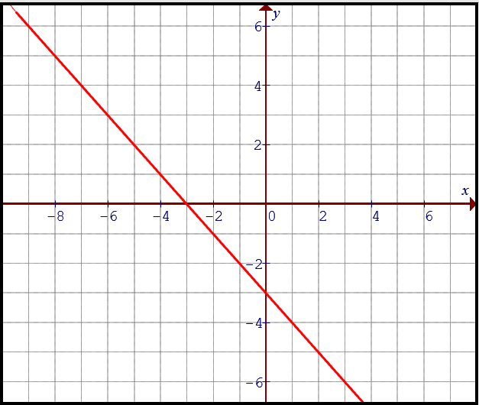
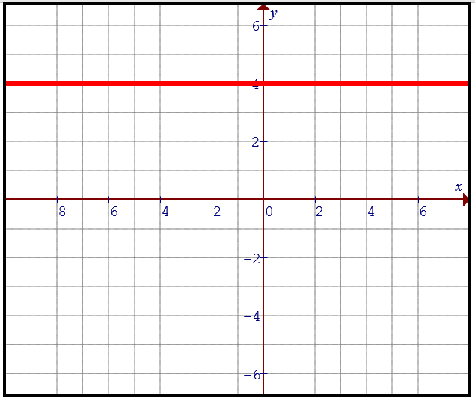
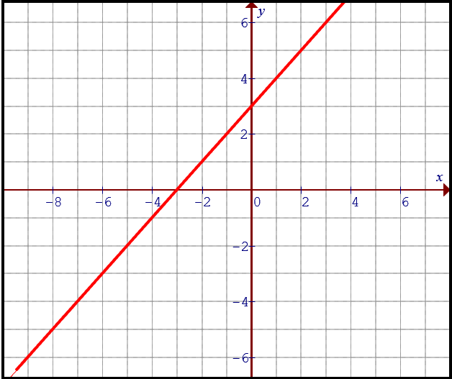
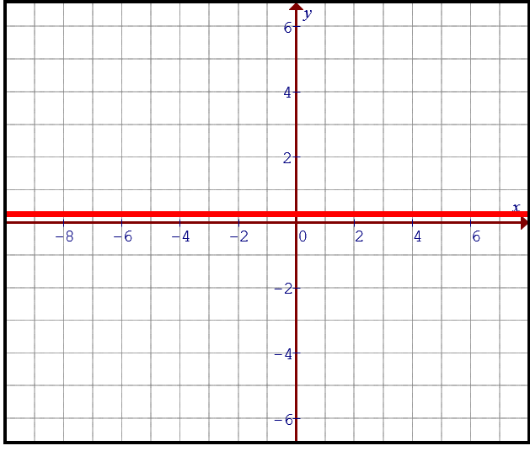
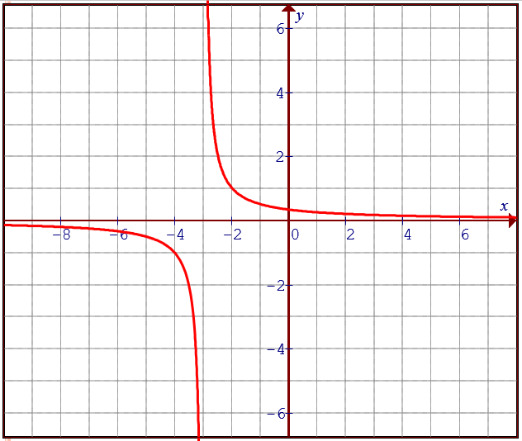
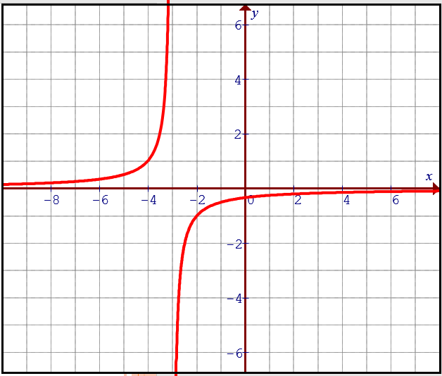
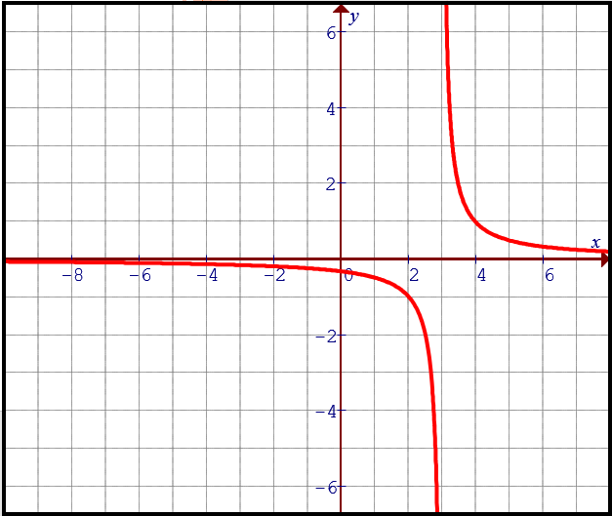
Ex: Please match each graph on top with the corresponding reciprocal function below:
A)
B)
C)
D)

Slide 10
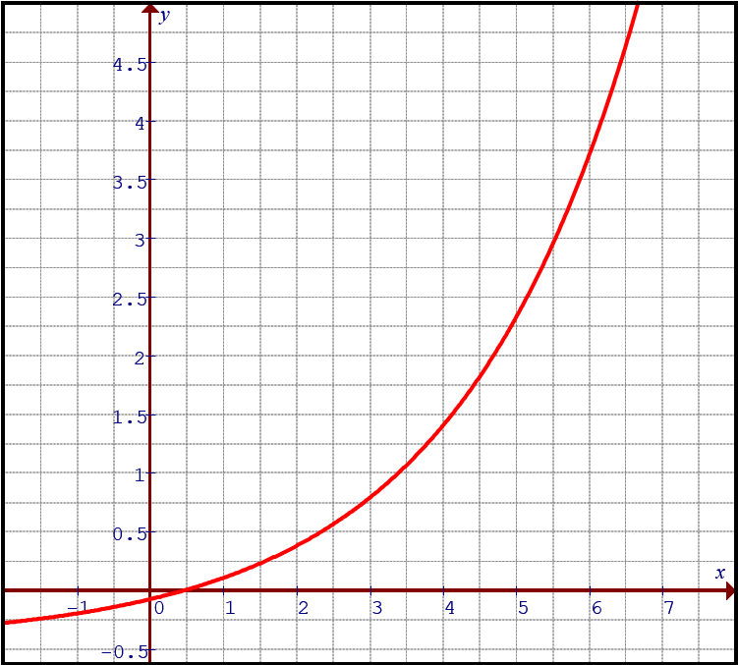
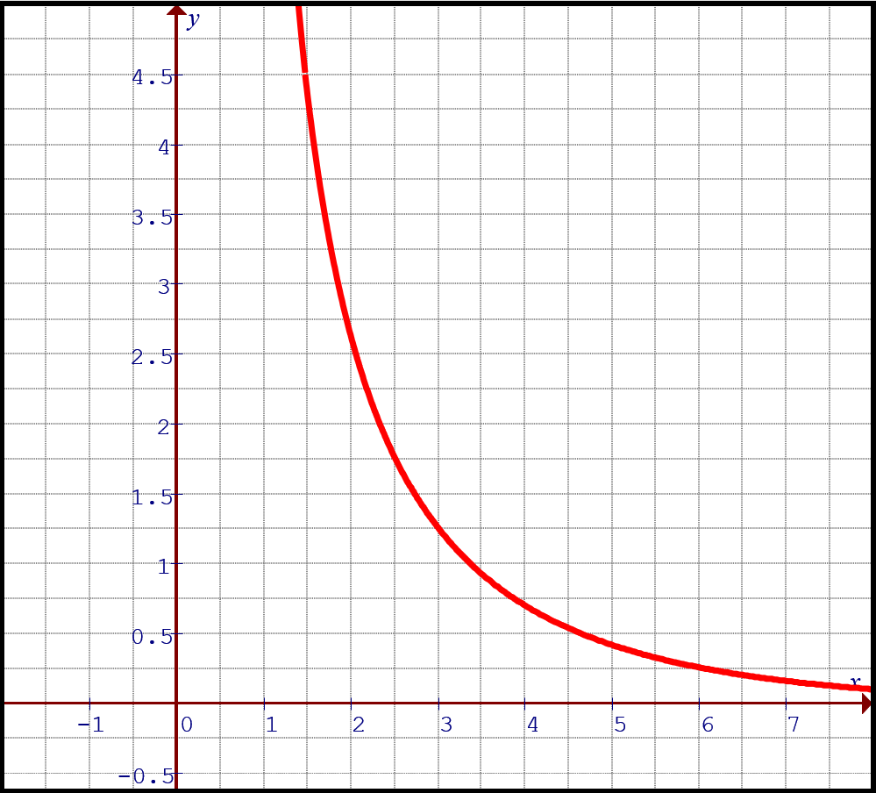
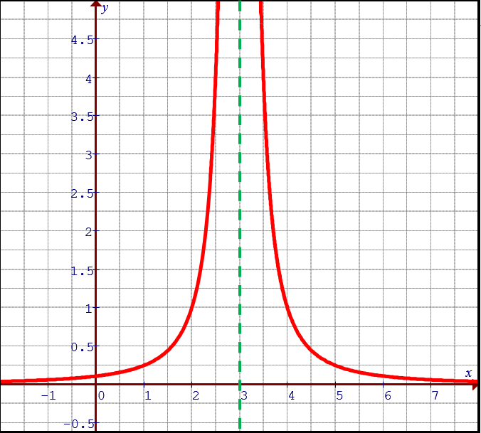
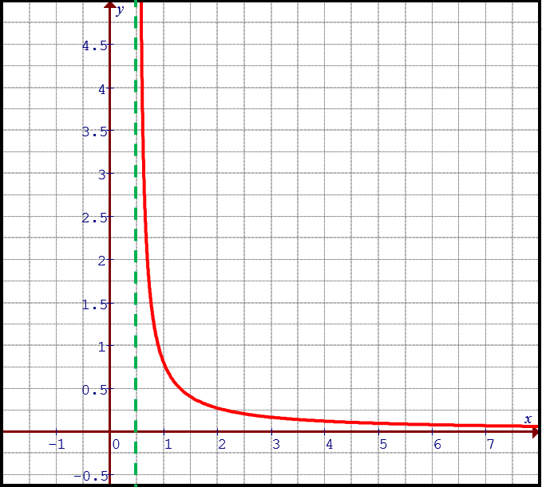
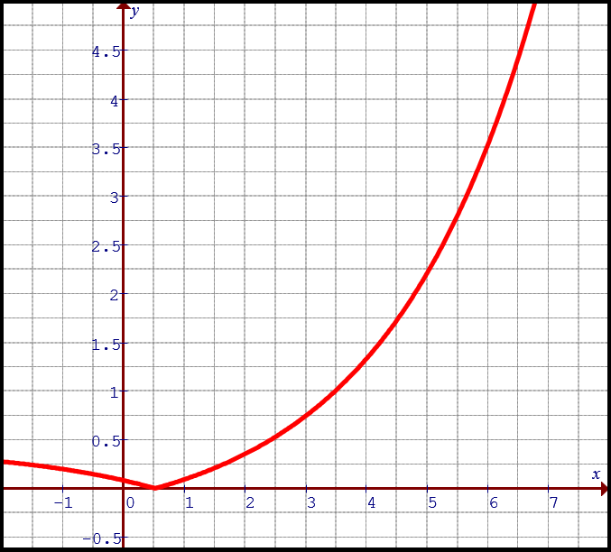
Ex: Given the following points on the curve, which of the following is the reciprocal of the given graph?
A)
B)
C)
D)

Slide 11
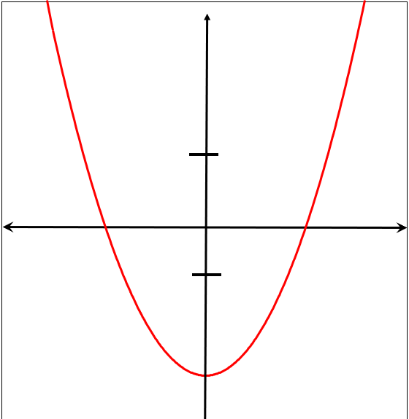
Graphing the reciprocal of a Quadratic function:
1. If a quadratic function has two X-intercepts, then each of those x-intercepts will become a vertical asymptote
2. Common points occur when the y-coordinate is either 1 or -1. So a parabola can have up to four common points.
You will two in the middle and one on the left and right
3. You will have 3 parts when drawing the reciprocal: LEFT, MIDDLE, and RIGHT.
4. Draw the reciprocal starting from the asymptote.
5. Near → Far, Far → Near (with respect to X- axis)

Slide 12
Practice: Graph the following
y
Pick some points on the original
Function and take the reciprocal
of the Y-coordinates. Reciprocal of large numbers will become small
Reciprocal of small numbers
Will become large
Graph
5
Find X-intercept →Asymptotes
x
Find the Common Points where Y coordinate is 1 or -1.
-4
0
4
-5
© Copyright All Rights Reserved Homework Depot www.BCMath.ca

Slide 13
Graph the reciprocal of each parabola
y
y
5
5
x
x
-5
0
5
-5
0
5
-5
-5
Use the first x-intercept to draw the
Vertical asymptote
There are no x-intercepts, so no VA
Only one invariant point
Plot the invariant points
Graph each side of the asymptote
© Copyright all rights reserved to Homework depot: www.BCMath.ca

Slide 14
Summary:
Reciprocal Function:
Graphing Reciprocals
Find x-intercepts → Vertical Asymptotes
Find common points: where the y-co- ordinate is 1 or –1
Big → Small Small → Big take the reciprocal of the y-coordinates only
Reciprocal and Inverse are not the same!!!

Slide 15
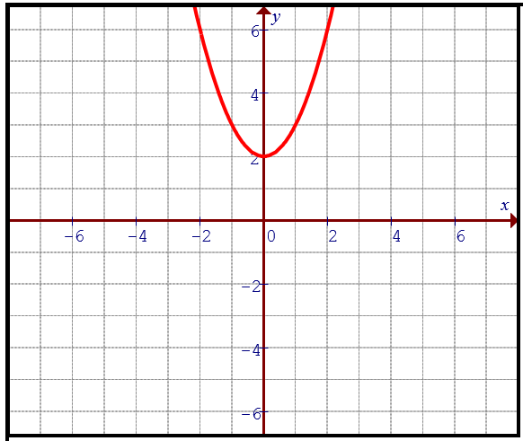
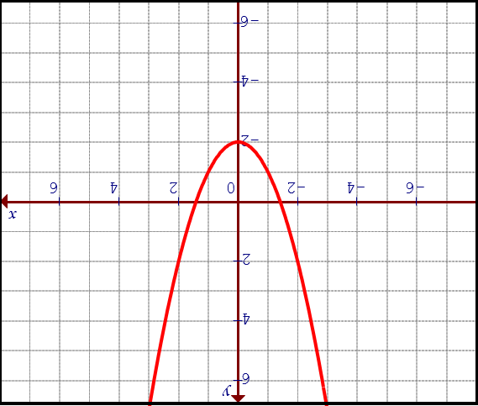
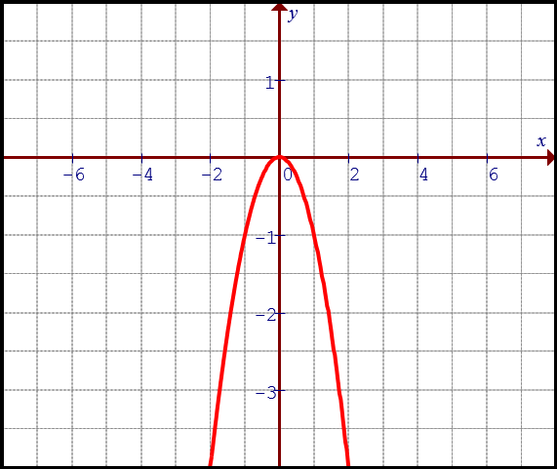
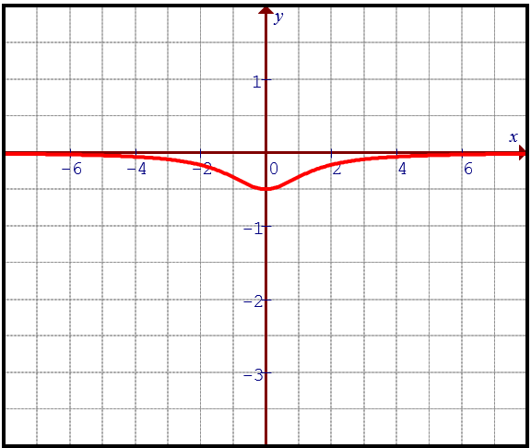
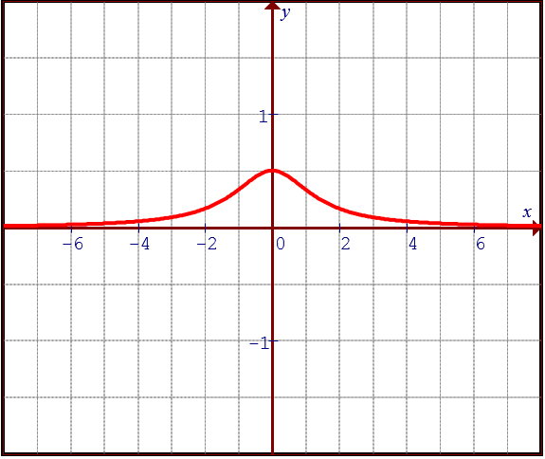
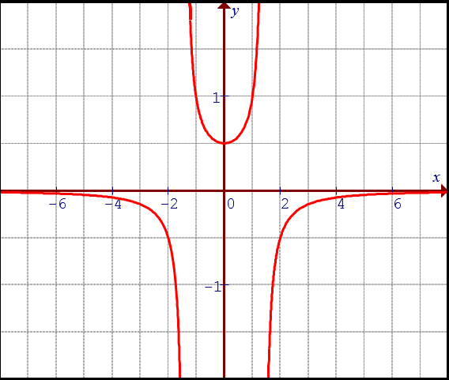
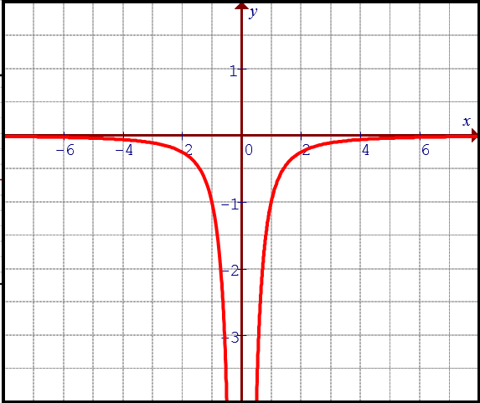
Ex: Match each parabola with the corresponding reciprocal function:
A)
B)
C)
D)

Slide 16
Given the following function, indicate the domain and Range:
© Copyright all rights reserved to Homework depot: www.BCMath.ca

Slide 17
Ex#) Given the following graph f(x), graph the reciprocal function.
Find X-intercept →Asymptotes
Find Common Points
Near to Far & Far to Near
© Copyright all rights reserved to Homework depot: www.BCMath.ca

Slide 18
Practice: Given the following graph f(x), graph the reciprocal function.
y
4
2
0
x
-6
-4
-2
0
2
4
6
-2
-4

Slide 19
Example 7: Given the following graph f(x), graph the reciprocal function.
y
8
6
4
2
0
x
-8
-6
-4
-2
0
2
4
6
8
-2

